Slide 1


Booking Management App GAD
By Oliva Alexandru

Slide 2
Application objective:
The objective was to create an application for small hotels and guest houses
The application is designed to help the administrators to organize the bookings in a better way
Only 3 apps on the market at this point (without synchronization)
The initial scope of this application was to synchronize different calendars and create a centralized point for other applications like (Airbnb, Booking, etc.)

Slide 3
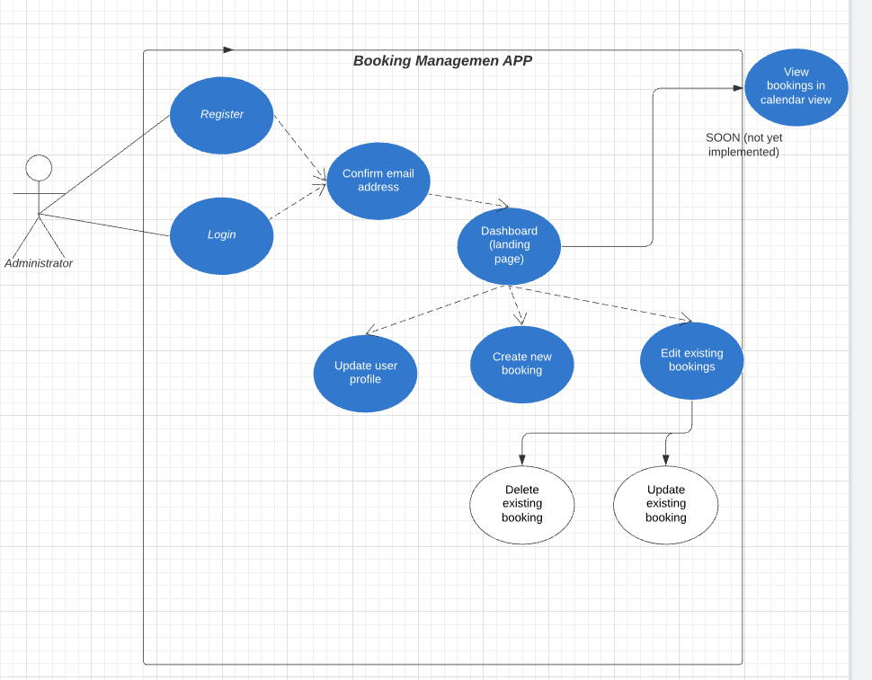
Use cases of the app:

Slide 4
Topics approaches and used in the app:
Firebase (Firestore database (NOSQL), FirebaseAuth, Firestore Recycle Adapter)
Fragments
Activities
Toasts
Constraint layout
Card-view layout
Intents
Bundles

Slide 5
Firebase is a Backend-as-a-Service (Baas). It provides developers with a variety of tools and services to help them develop quality apps, grow their user base, and earn profit. It is built on Google's infrastructure. Firebase is categorized as a NoSQL database program, which stores data in JSON-like documents.
So, what is firebase?

Slide 6
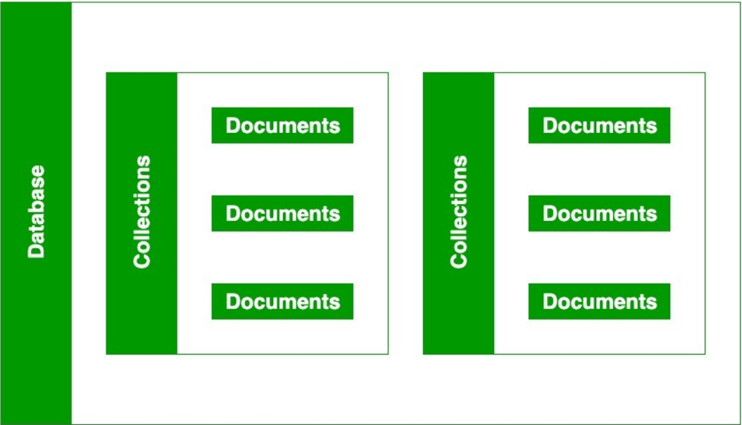
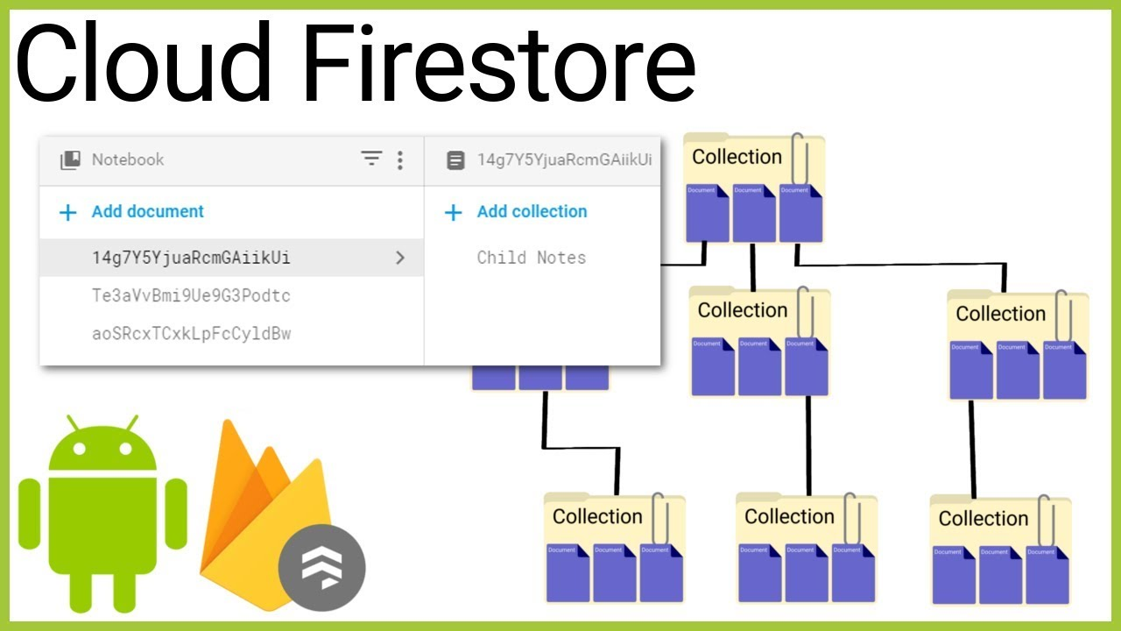
About Cloud Firestore:
It’s a NoSQL database
It’s composed by collections and documents
You can store data in structures of data

Slide 7
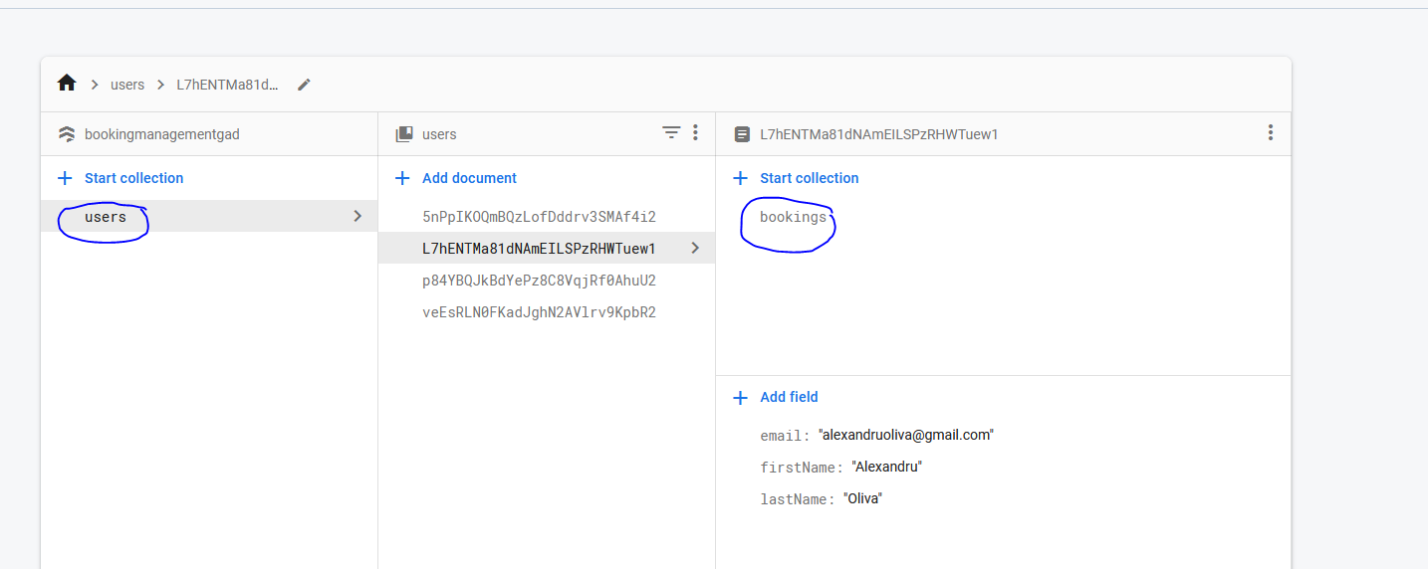
How my Firestore database is looking like:

Slide 8
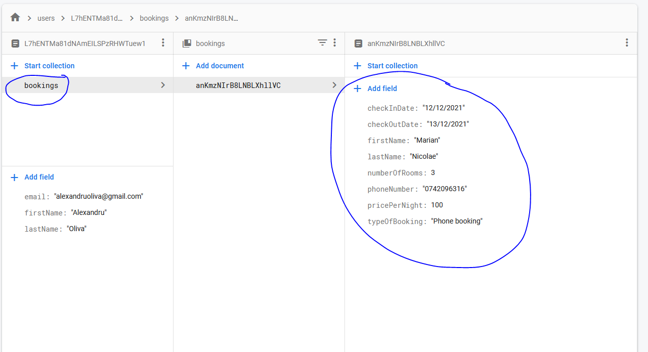

Slide 9
What I did wrong:
The register and login is sometimes slow (idk why)
The app doesn’t ask the user how many rooms does he have (didn’t have enough time to implement this)
The front-end of the app is not created by typing. Most of it is created by drag and drop.
Wrote a lot of boilerplate and didn’t refactor correctly (e.g.. Creating a common class for some firebase instances and for some GUI elements)
When I started the app I spend a lot of time on designing the GUI
Created a new booking and user is not sanitized 100%
My logout button is not correctly logging out the user. (Couldn’t fix this bug)

Slide 10
What I did good:
Created a different fragment for each of the use-case (excepting the dashboard and login/register activities)
Used the Firestore recycle view adapter which was very useful and easy to adapt in the code.
Did a lot of commits
Created different branches for some features
Created a common background resource for all activities and GUIS (probably in the feature I will use this approach more when starting the development of an app)
Defined models for my entities (Booking, User)

Slide 11
My suggestions and conclusions:
Refactor in that moment
The design of is not that important (work next time more on the functionalities)
Do research before starting an app (Airbnb doesn’t provide API’s, Booking does)!
Firebase is a very useful API but at one point it will be too expensive (https://firebase.google.com/pricing)
Use GIT and commit frequently (not one bulk commit)
Test it frequently, after every little change in the code
Use the same pack of icons for consistency

Slide 12
To be implemented in the feature:
Calendar View
Redesigning the architecture of the app to ask the user for the number of rooms
Synchronizing calendars
Validate and sanitize the app better

Slide 13
DEMO TIME

Slide 14

Thank you!

